Slide 1

A Sneaker selling website with a built-in recommendation system
By Salman Talib

Slide 2
Introduction
Overview: Introducing an innovative E-commerce platform with an intricate recommendation system.
Purpose: Addressing the growing demand for personalised shopping experiences, especially in the sneaker market.
Need: With the surge in online shopping, consumers seek curated recommendations for their unique preferences.
Target Audience: Primarily targeting sneaker enthusiasts and fashion-conscious individuals.
Objective: Offering a seamless blend of convenience and personalisation through the recommendation system.

Slide 3
Project’s Objectives
Create a platform that displays an assortment of different sneakers that the user is able to view and purchase.
Integrate a recommendation system that observes the user’s behaviour, preferences, and past interactions with the platform to generate personalised product suggestions.
Design a straightforward interface that is able to attract users and effectively entice them into exploring the platform, thus likely of them viewing and purchasing items from the site.
Layout the platform to create a navigable environment where the user can easily explore the site and is able to inspect items of their interest, formed by the recommendation system.

Slide 4
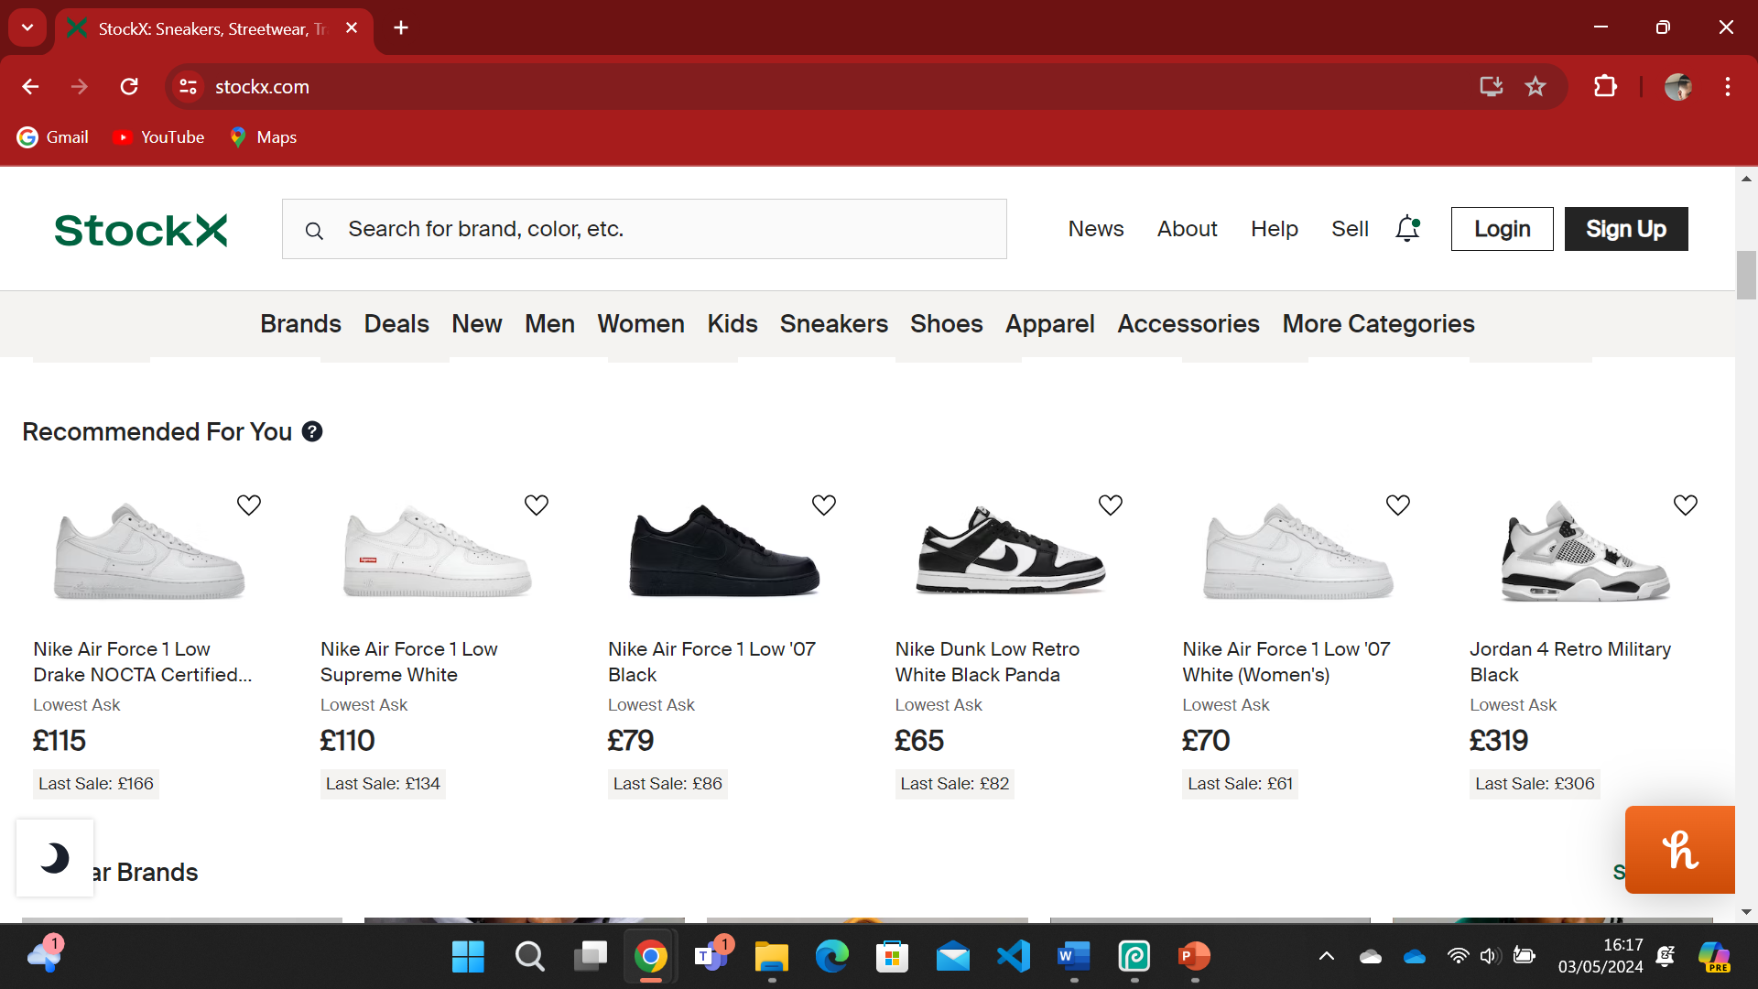

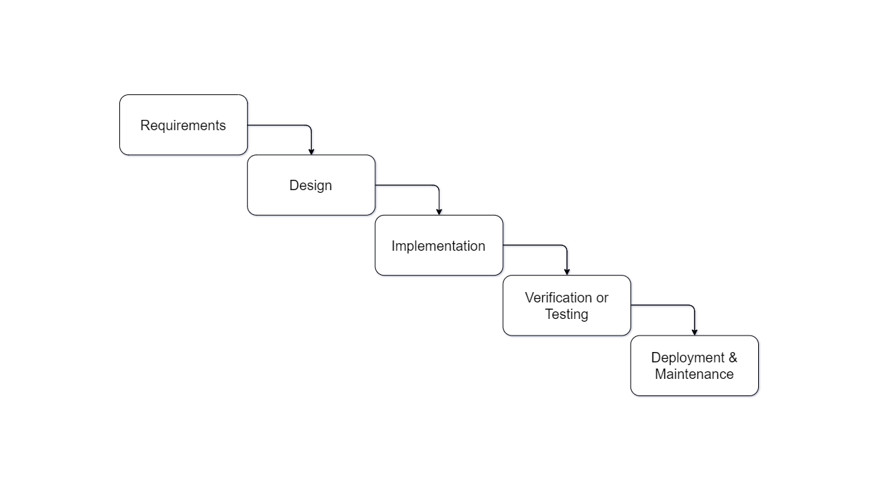
Literature Review
Systems Review: Sneaker selling websites such as Nike, StockX, and Laced were looked upon for their website design and recommendation systems.
Security: Awareness of ethical issues and security risks such as XXS and SQL injection is vital for project compliance and user data protection via the UK GDPR and University’s data protection policy.
Tools & Techniques: The use of the Waterfall development methodology has helped the project going forward in phases (Frameworks mentioned in Use of Software slide).

Slide 5
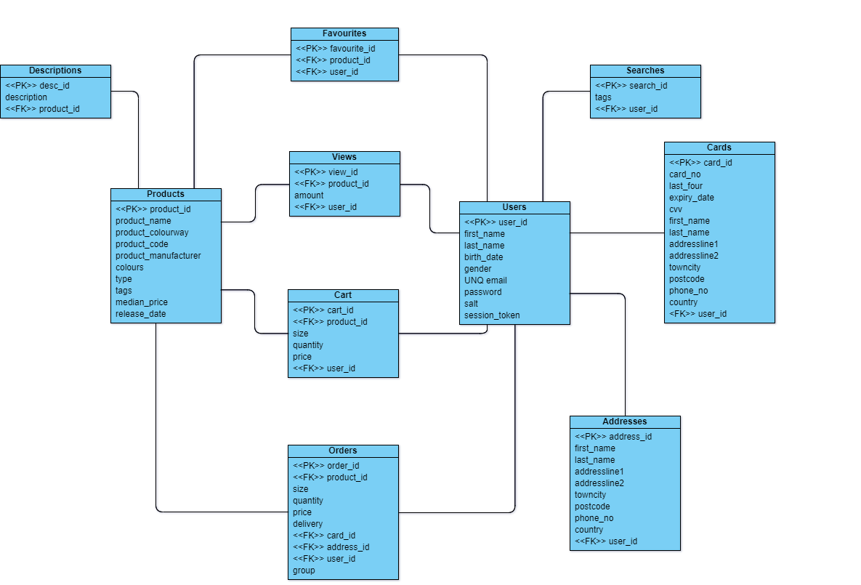
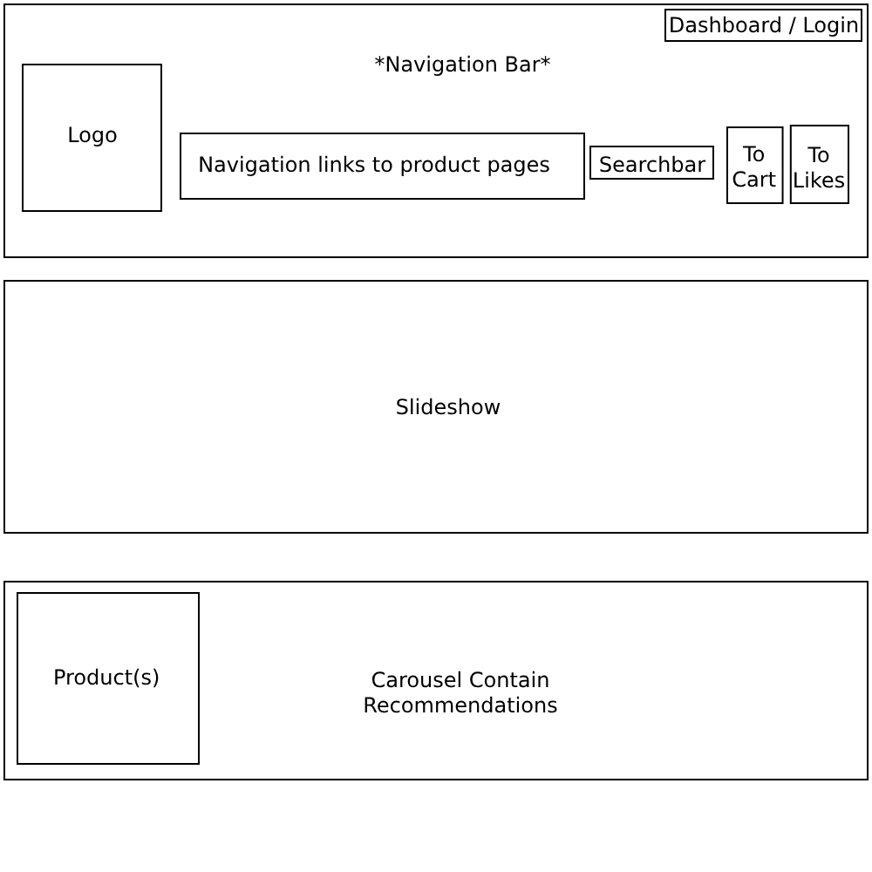
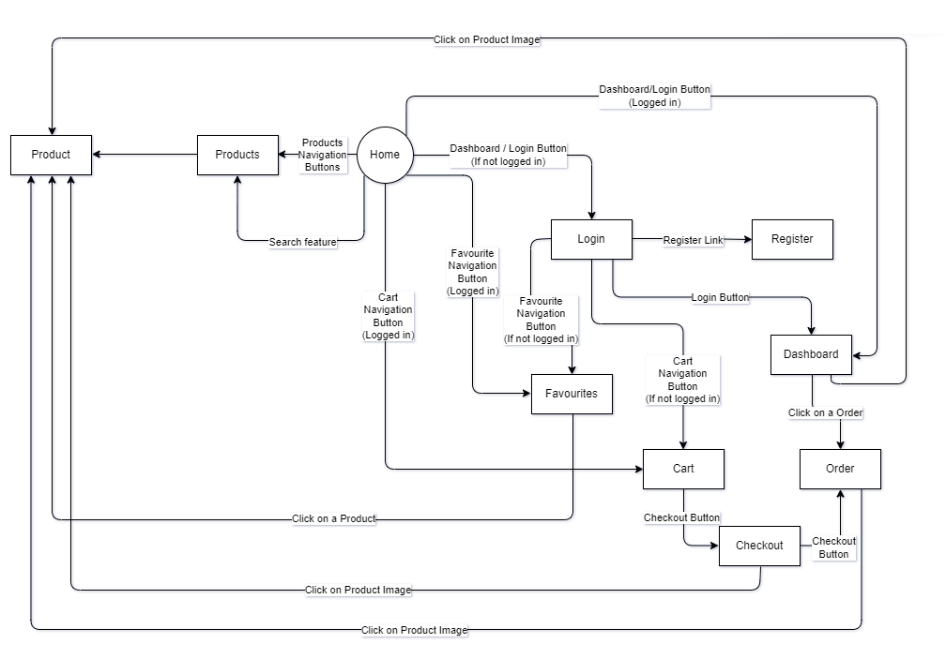
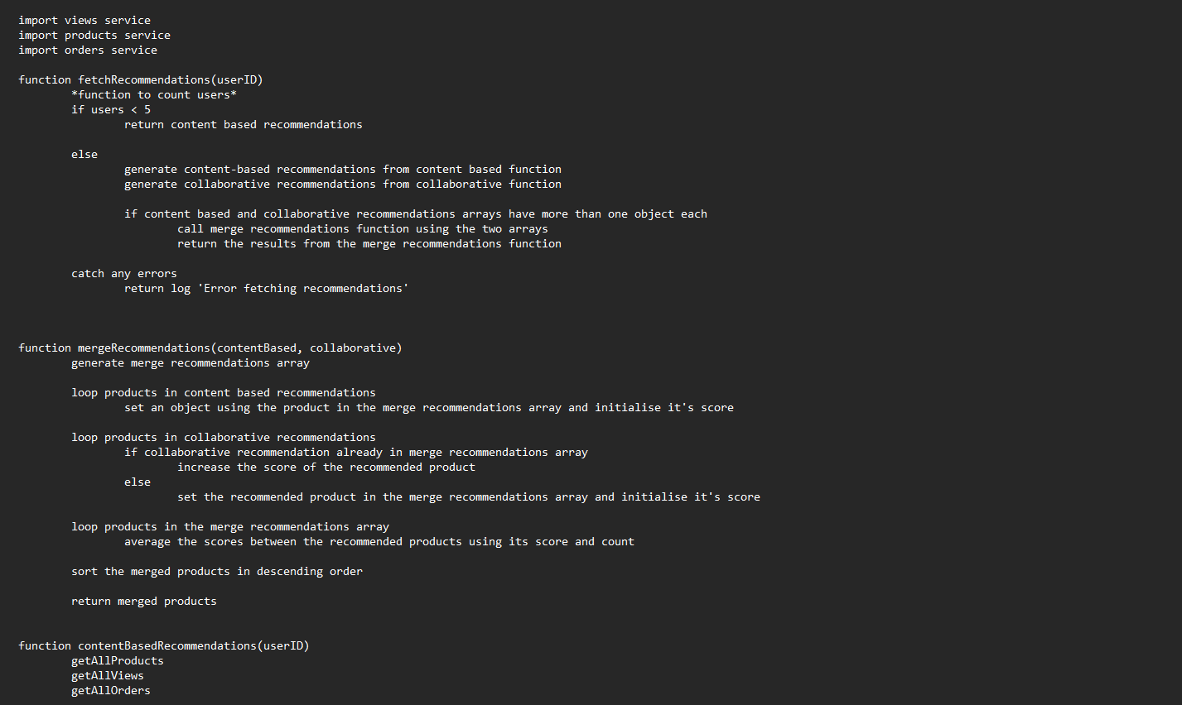
Design Documentation
ERD: Essential for database design, ensuring clarity, laying out relationships, and providing valuable documentation for system maintenance.
Wireframe: Created page designs with each element of page labelled to layout the project’s website.
Navigation diagram: Mapping out page-to-page navigation and providing a blueprint for website.
Pseudocode: Planning out the recommendation system’s logic and providing a clear roadmap for implementation and testing.

Slide 6
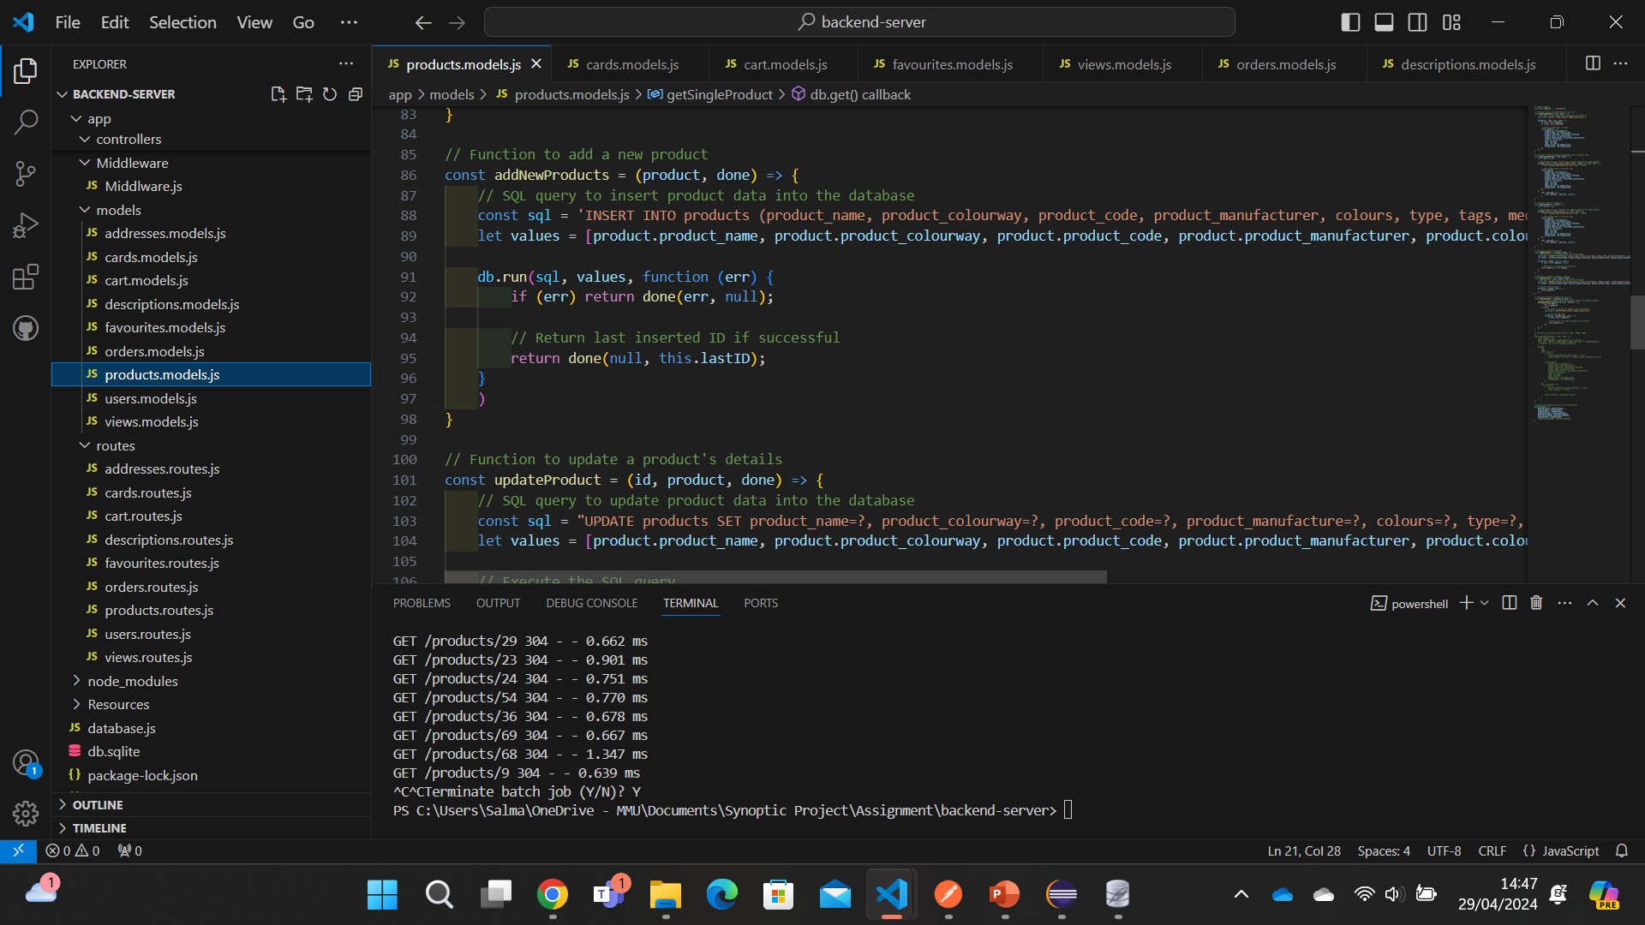


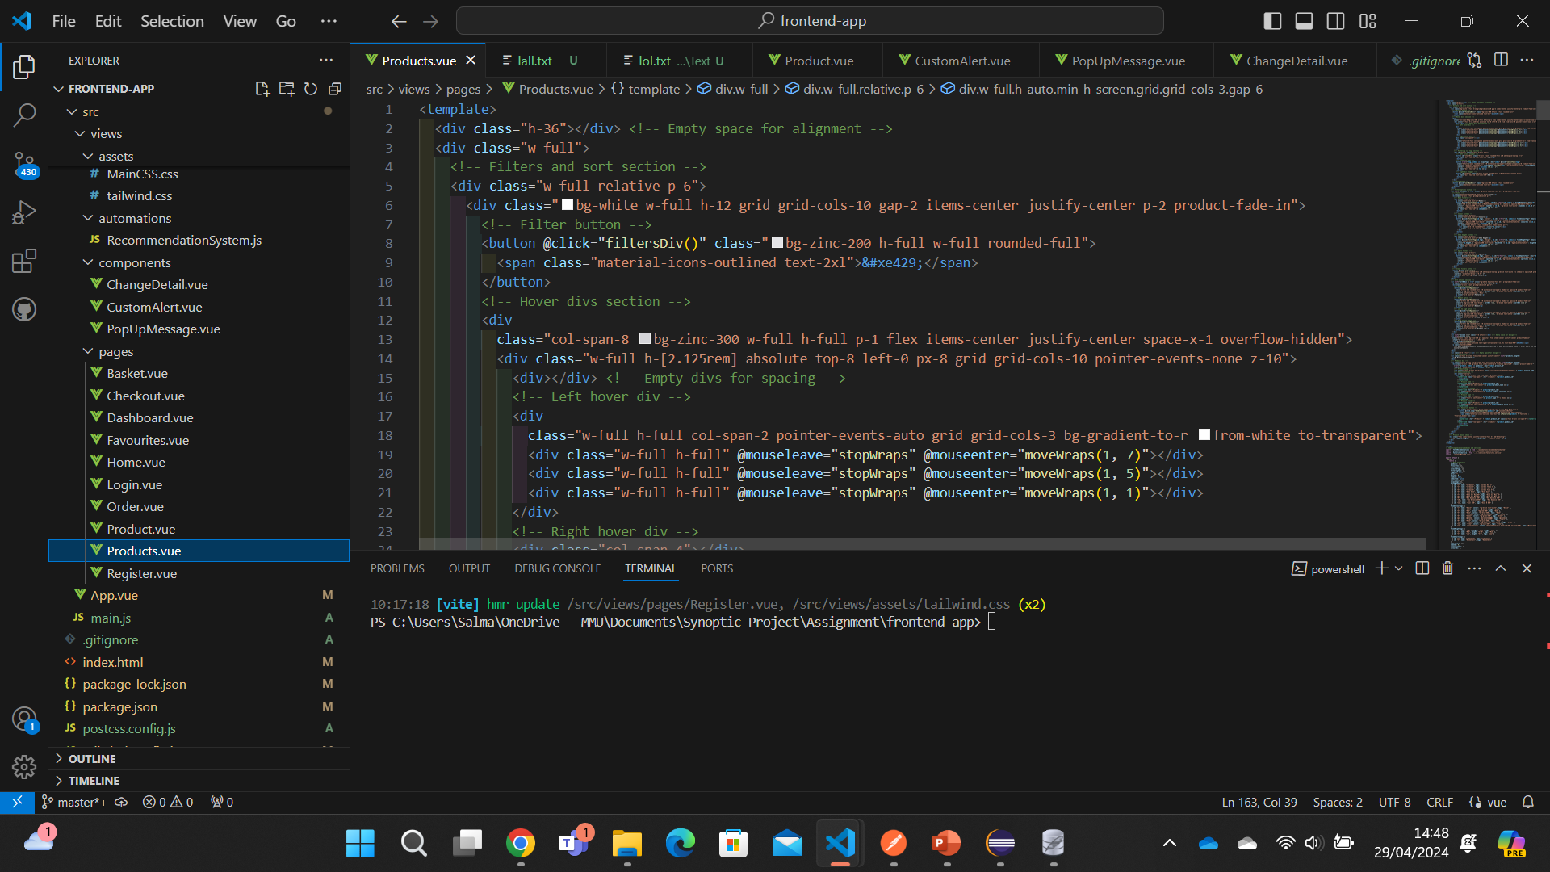

Use of Software
IDE: Visual Studio is the IDE of choice due to familiarity.
Server-side/Backend: Express.js is a Node framework that is used for the backend.
Client-side/Frontend: Vue.js is a frontend framework with it previously used in other projects.

Slide 7
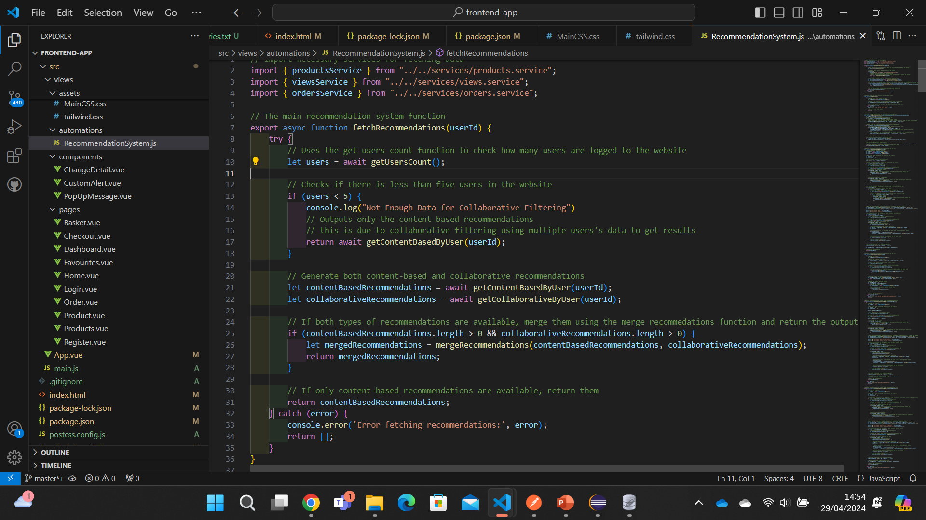
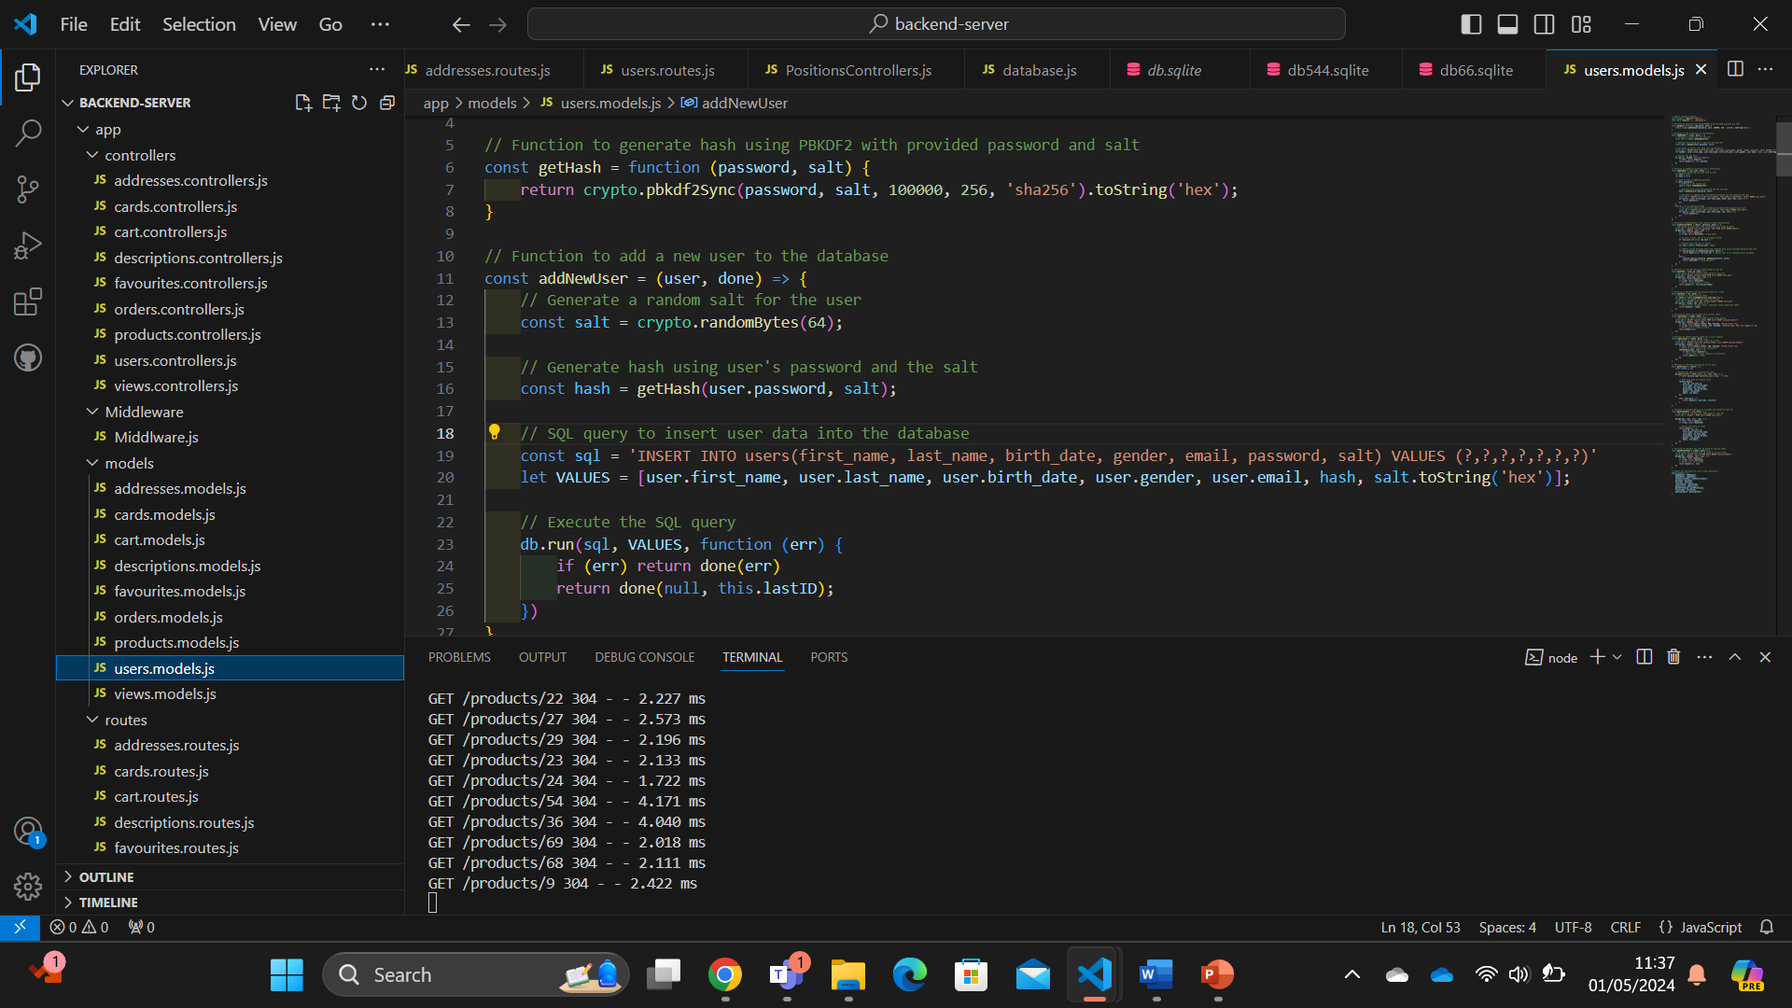
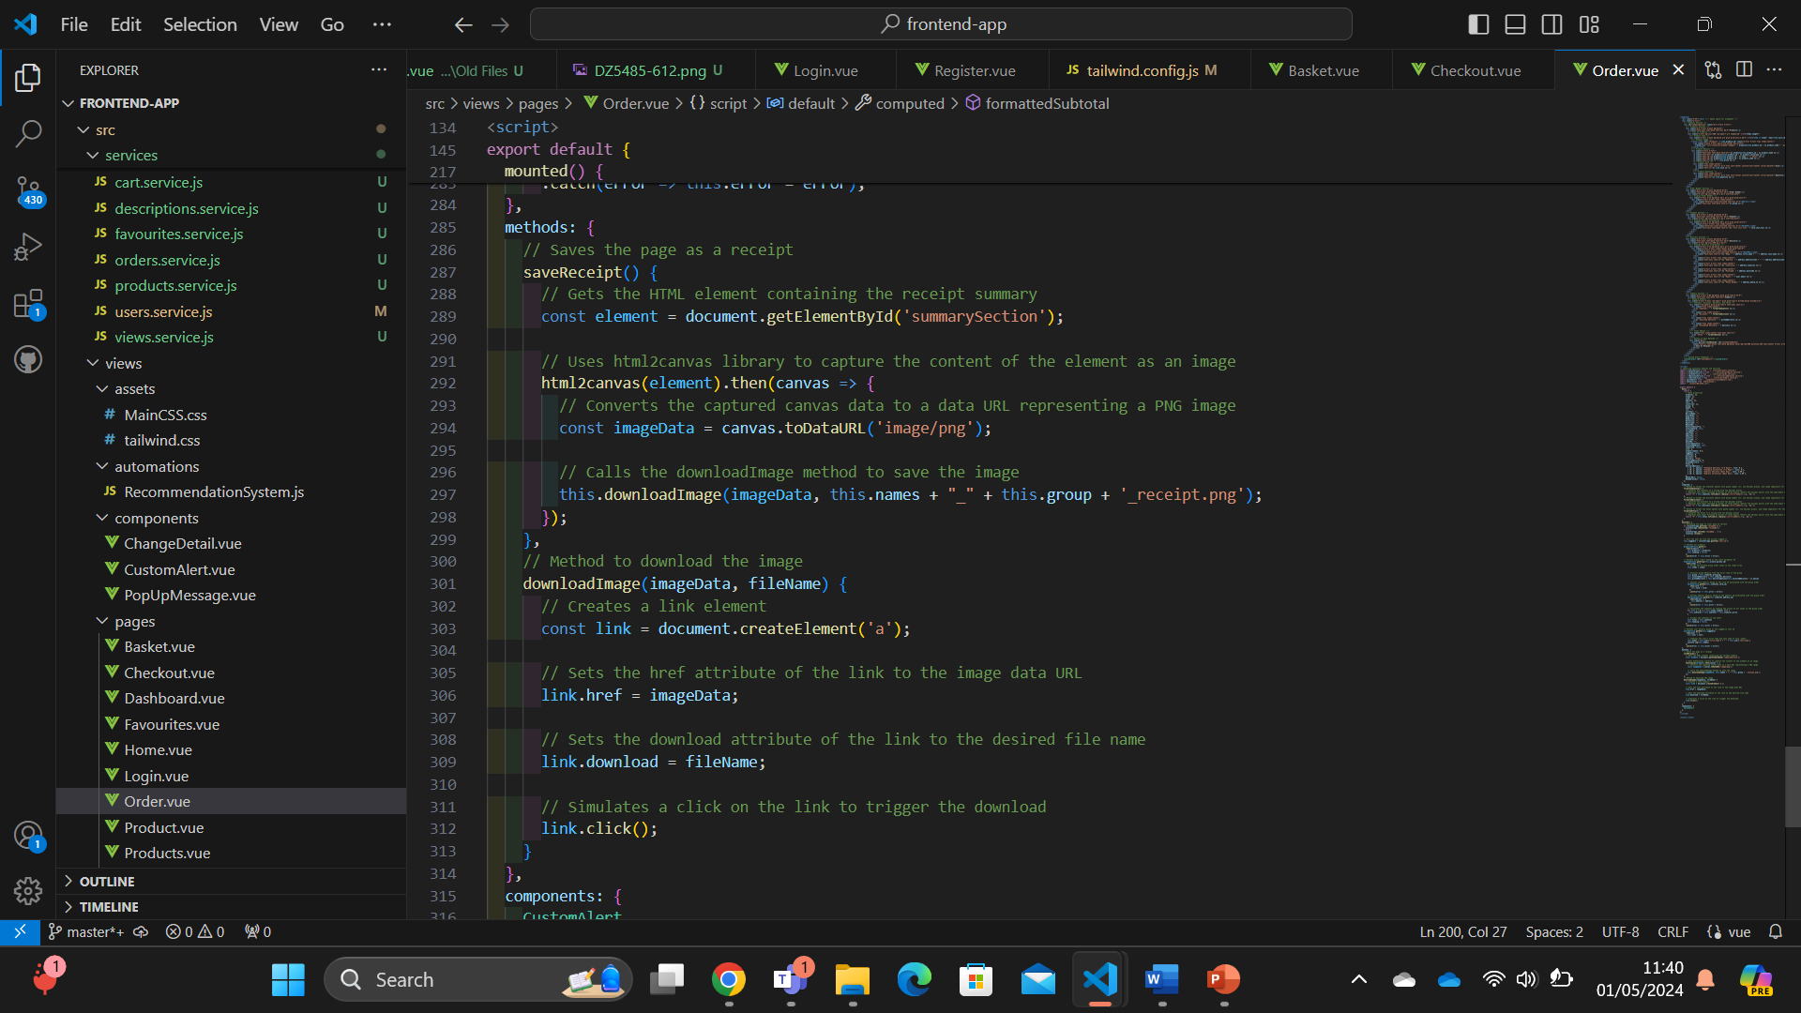
Impressive coding
Recommendation System: contains most complex set of functions on the website including content-based and collaborative functions.
Password Security: Other functions include related items to products and product
Save Receipt: Saves receipt as a PDF, taking elements of the page for receipt content.

Slide 8
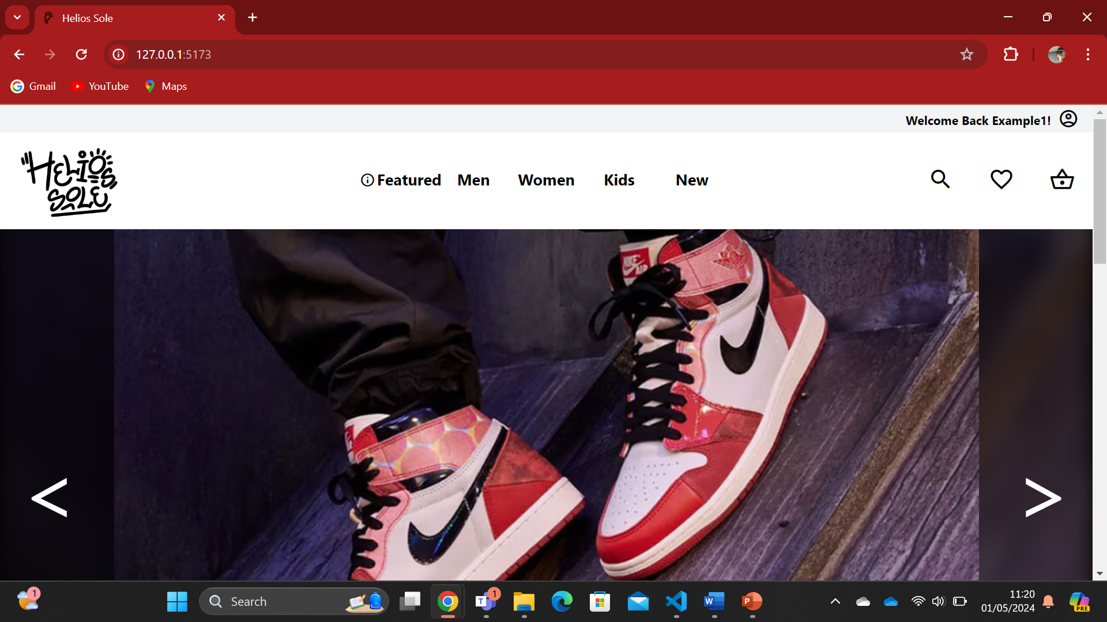
Demo

Slide 9
End of Presentation
Thank you for overseeing my presentation and demonstration.
If you got any questions, you may ask them now.

